Slide 1



LEAVE THE
GRADING
ON US!

Slide 2


Problem
Which teacher wants to grade so many answer sheets?
Problem 1
Underdeveloped educational societies do not have well
standardized assessment methods.
Problem 2
Exams take place no more than twice a year.
Problem 3
Quality of education gets affected and students are
not assessed on a regular basis.

Slide 3
Problem Factors
Which teacher wants to grade so many answer sheets?
Problem 1
Assessing students is time consuming and can be
financially heavy for such rural institutions.
Problem 2
No uniformness in correction as there aren’t much rules and regulations to be followed.
Problem 3
Lack of time and other resources for such rural scenarios makes it even more complex.

Slide 4
Approach
Our solution is simple and requires zero custom hardware.
1
An application which runs on your phone and uses OCR and image recognition to automatically assess answer papers.
2
The score generated is then stored in spreadsheets for personal use and mechanized to dispatch through SMS.
3
This aims at a more acceptable and faster assessment.
More involvement of parents with their child’s progress.
4

Slide 5

What would the student need?
Pen
A pen would be preferable than a pencil for the OCR.
Paper
Don’t expect these students to have electronic devices, will you?

Slide 6


Step 1
1
Scan the answer sheet
Step 2
2
Birth of S2K Grader
Gets graded automatically
A simple android application to scan MCQ based answer sheets, extract question and answer pair; automated comparison with answer key and the result is then stored and send offline.
Step 3
3
View and send results

Slide 7
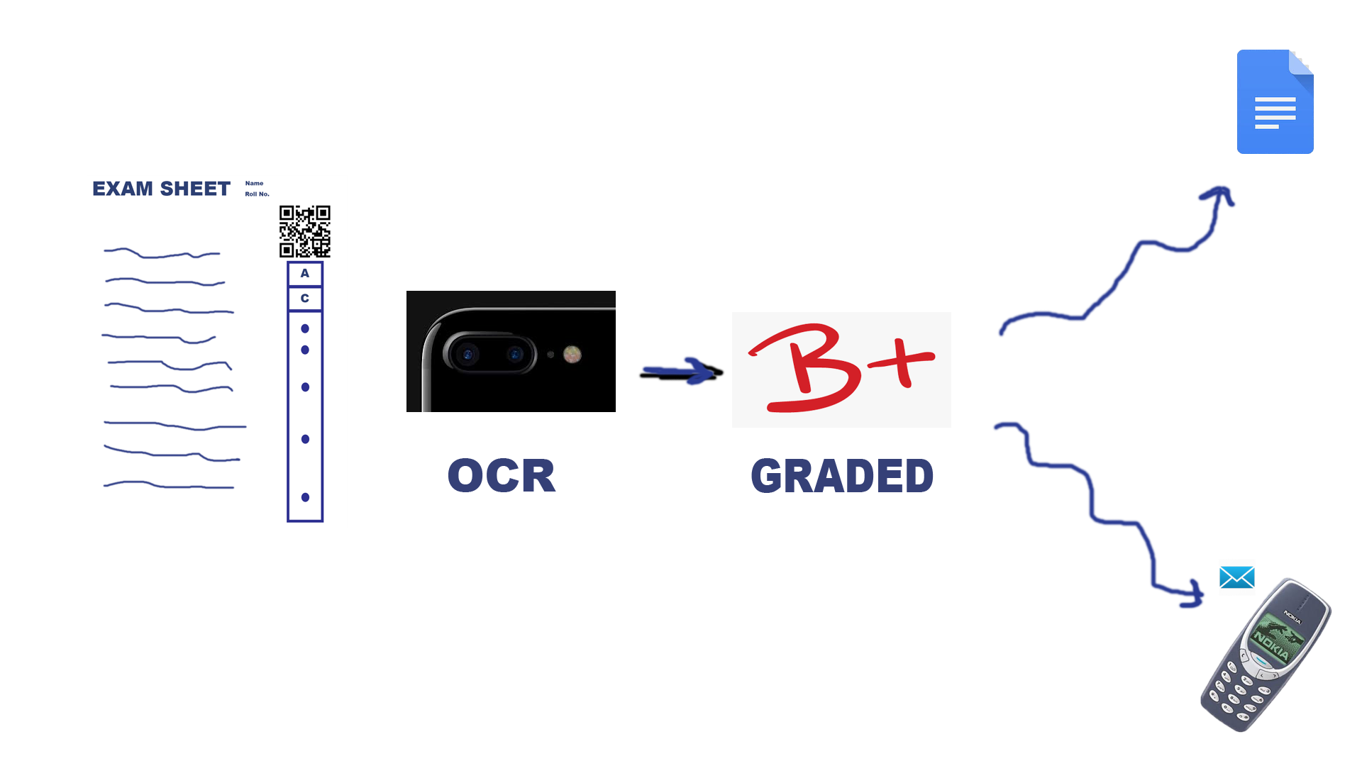

Slide 8




Solution 1
Providing students with multiple assessments and quizzes.
The Utopia
Solution 2
Automated grading makes work
for the teachers, a breeze.
“The S2K Grader”
Solution 3
Let their guardians know, because they don’t want to make them angry.

Slide 9





Tech Stack
Android Studio
Built an app which scans, extracts and delivers.
Firebase
Moving data from one place to another isn’t that easy.
Python
Prove me wrong if there is a better programming language.
Twilio
The messages have proven to be delivered 99.999% of times, so watch out!

Slide 10
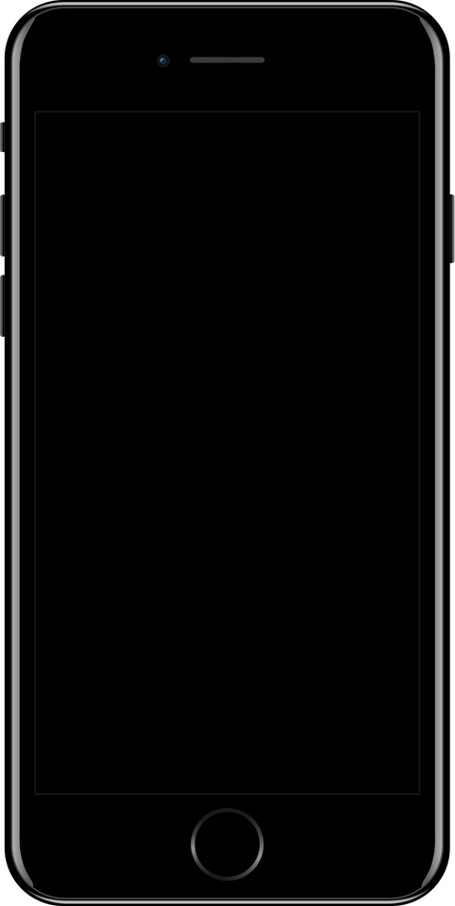
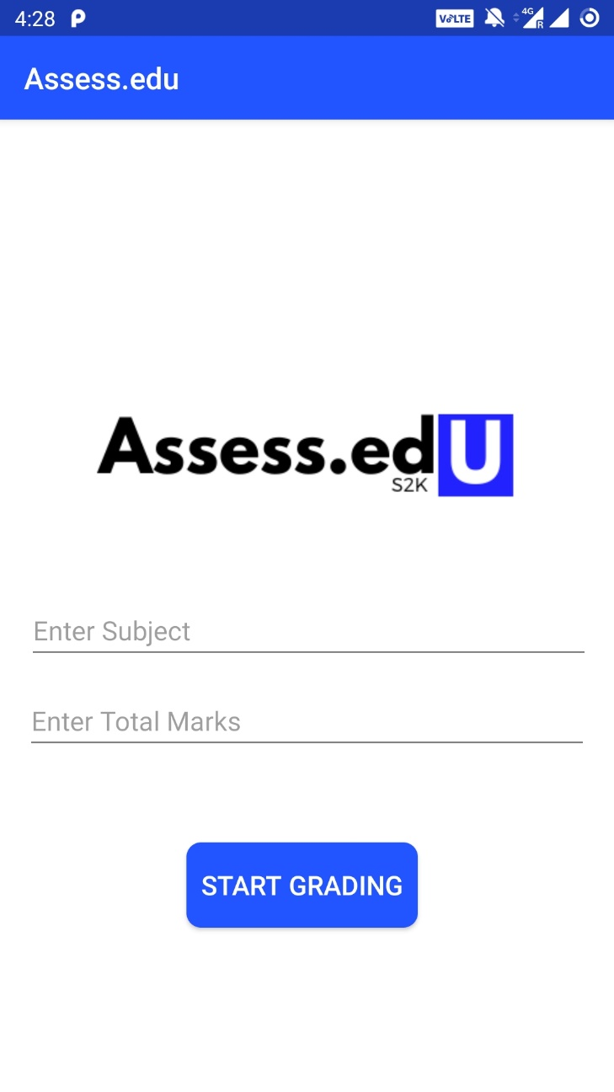
Android Application
Simple and Concise.

Slide 11
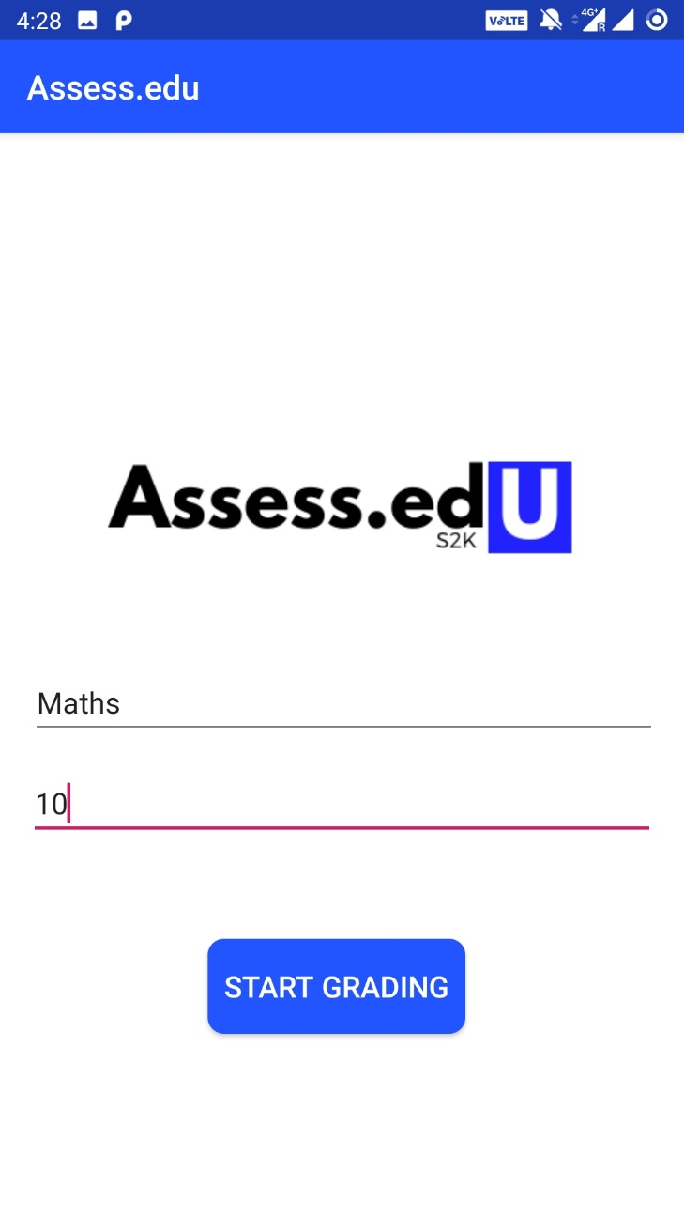
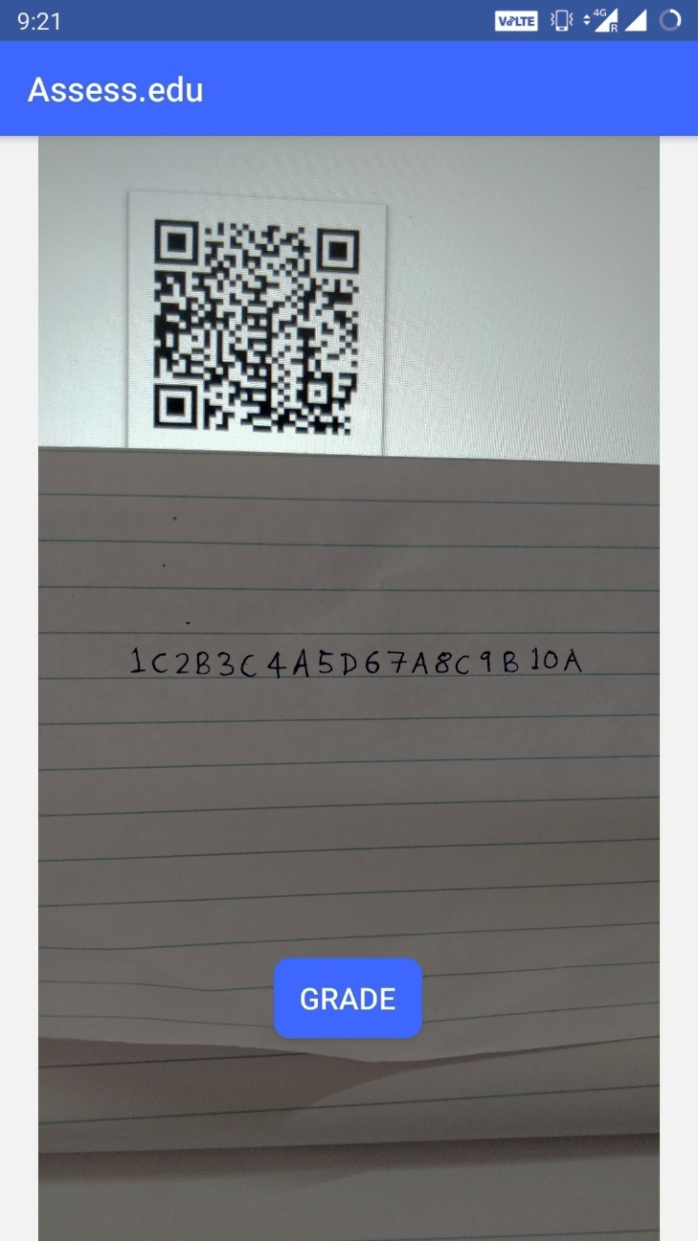
STUDENT ID

Slide 12
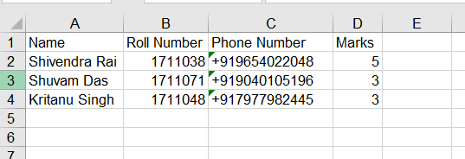

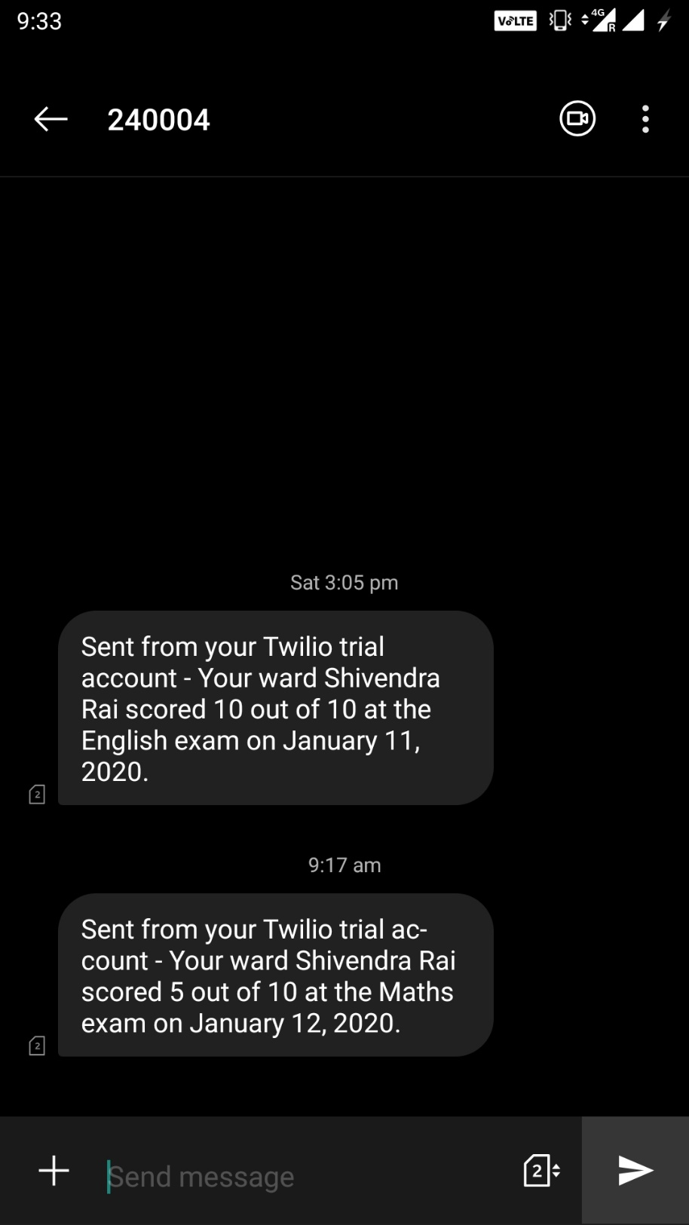

Slide 13
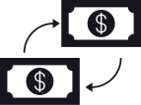


Business Model
Either the software application can have a one-time payment for unlimited scans.
1
Subscription based plans with scan amount capped at a certain number.
2
Integrated with partnered devices and included with the production costs.
3

Slide 14


Future Roadmap
Step 1
1
Robust System Config
Steps to be followed to scale this application and reach the needful.
Step 2
2
Gather seed money
Step 3
3
Bulk Distribution
Step 4
4
Analysis and Enhancement

Slide 15

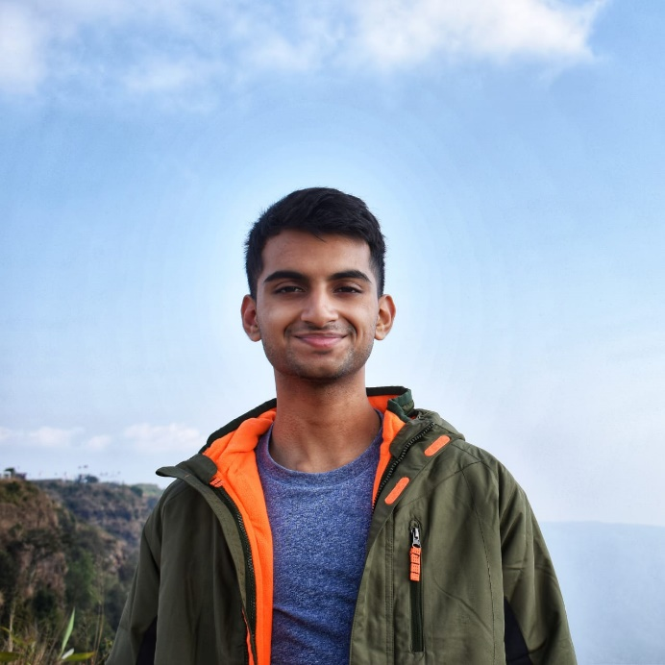
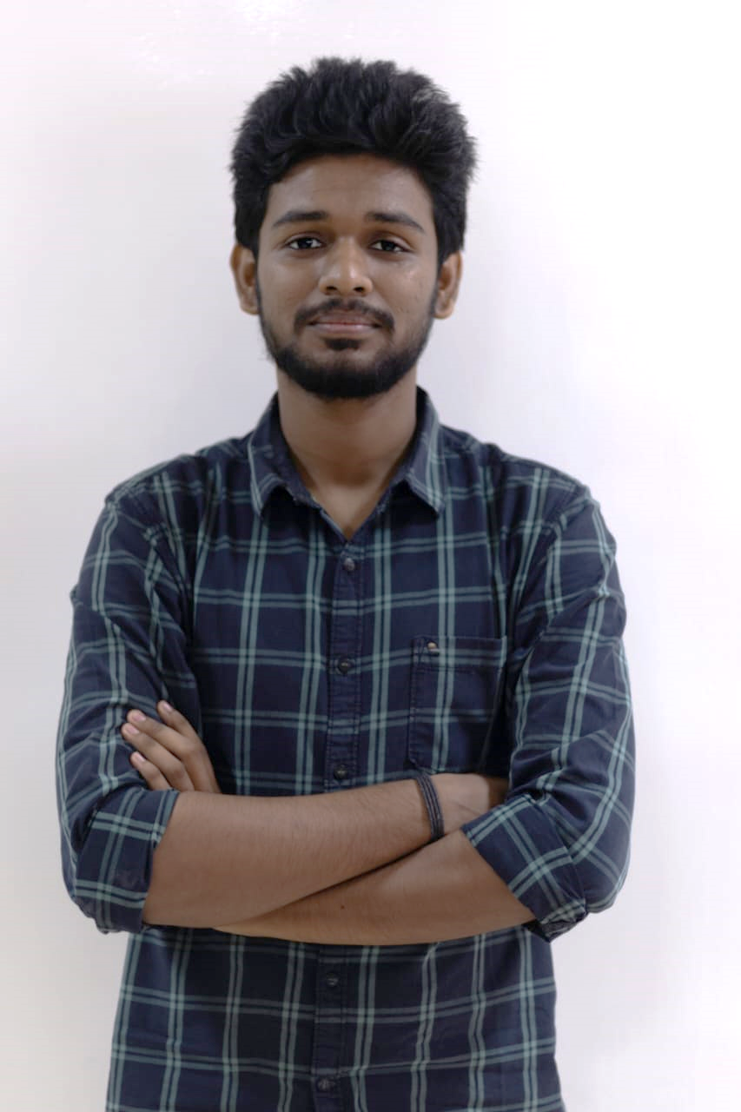

The Team
From Chennai
Shivendra
Rai
Shuvam
Das
Kritanu
Singh
App/ Web
Web/ Python
Python/ Design

Slide 16






Thank You!
For having
us here.

